Slide 1
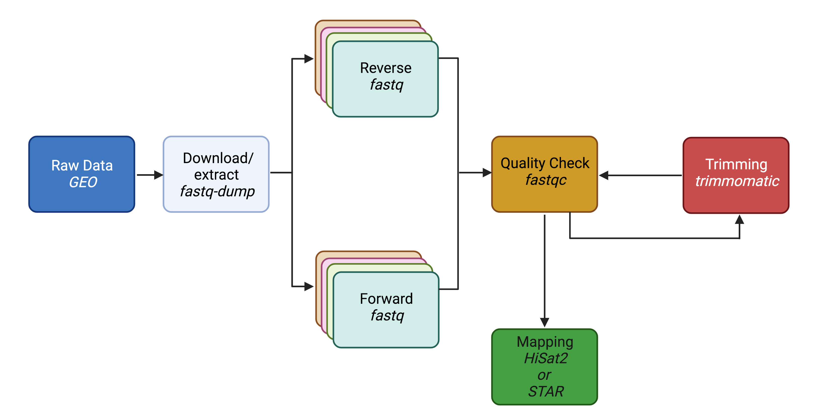
Trim galore
Lecture 8: Mapping
February 27, 2024

Slide 2
Outline
Lecture for ~10 mins
Class Activity #1 = 10 minutes
Lecture for ~15 minutes
Class Activity #2 = 10 minutes
Any remaining time will be time to chat with me

Slide 3
Learning objectives
Explore the splice-aware mapper called STAR and HISAT2
Index genome with HISAT2
Begin to understand file outputs after alignment

Slide 4
Trim galore
Past Topics
This Weeks’ Topics

Slide 5
FASTQC recap

Slide 6
Step 1: FASTQC
Two basic questions of QC
How successful was the actual sequencing?
High base call confidence <30 phred score
Did the library prep generate a faithful representation of the DNA/RNA molecules in the sample?
No contaminations (rRNA, adapters, primers, etc.)
No bias towards fragments of certain GC contents/sizes

Slide 7
Trimming

Slide 8
Step 2: Clean the FASTQ files
Raw reads may suffer from the following:
Presence of adaptors
Low quality reads
Or other issues that result in low base call
Trimming is optional
Caution: Avoid aggressive clipping as this could cause miss-mapping

Slide 9
Why optional?
Modern “local aligners” like the STAR aligner, will “soft-clip” non-matching sequences
Other pseudo-aligners like Salmon or Kallisto will not have a problem with reads containing adapter sequences
However, if the data is being used for variant analysis or genome assembly, reads should be trimmed

Slide 10
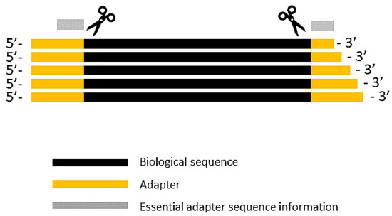
Common programs used for trimming
Preprocessing of FASTQ can be performed by a variety of programs
fastp
Trimmomatic
Trim galore
Cutadapt

Slide 11
How would you run “trim galore”?
Install it in your personal VACC account and then be able to call it (ex. multiQC)
Or load it from the shared computing cluster using module package (ex. fastqc)

Slide 12
Use module to load
module avail – to see what programs are available
module load trimgalore-0.6.4-gcc-7.3.0-kml55yf
Use tab completion!

Slide 13
Class Activity #1
Open the Trim Galore exercise in the course website
This will take ~10 minutes

Slide 14
Once trimmed, need to run fastqc again!
Trim galore
If bad…

Slide 15
Mapping to Reference

Slide 16
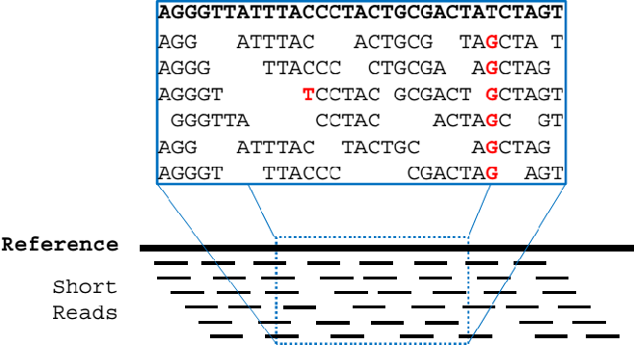
Read alignment / “mapping”
we are identifying the genomic origin of the sequenced cDNA fragment
Notes:
During library preparation, the DNA is fragmented and these fragments are completely mixed-up. The goal of read alignment/mapping is to put things back into place i.e. determine which read goes where in the genome. We are identifying the genomic origin of the sequenced cDNA fragment. This is the most crucial step of the entire experiment.

Slide 17
The general challenge
The general challenge of alignment following high-throughput sequencing is to map millions of reads accurately and in a reasonable time, despite the presence of sequencing errors, genomic variation, and repetitive elements.

Slide 18
The challenge with RNA-Seq specifically…
The sequencing library was constructed from transcribed RNA, intronic sequence are not present, and these sequenced molecule natively spanned exon boundaries.
Two categories of reads:
Reads that map entirely within exons
Reads that span two or more exons

Slide 19
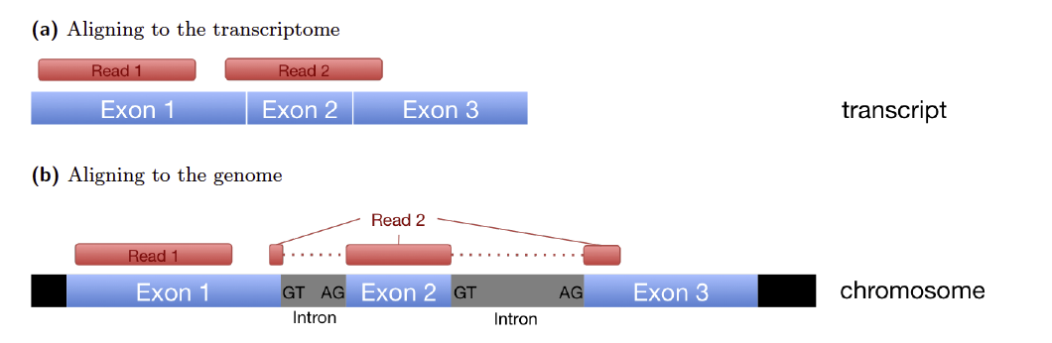





Exon-exon spanning reads
Gene
Isoform 1
Isoform 2
Reads
Notes:
The main challenge of RNA-Seq in particular is the spliced alignment of exon-exon spanning reads and the presence of multiple different isoforms of the same gene.
Short reads can cause ambiguity in mapping different splicing isoforms

Slide 20
Some opt to align to transcriptome instead
If you are mapping reads to a transcriptome intron/exon boundaries are irrelevant
Notes:
To mitigate this problem, there are programs which align to the transcriptome.

Slide 21
Mapping
counts.matrix
1
mapping
(trimmed FASTQ)
GENOME
SAM to BAM
TRANSCRIPTIOME
counts.matrix
2

Slide 22
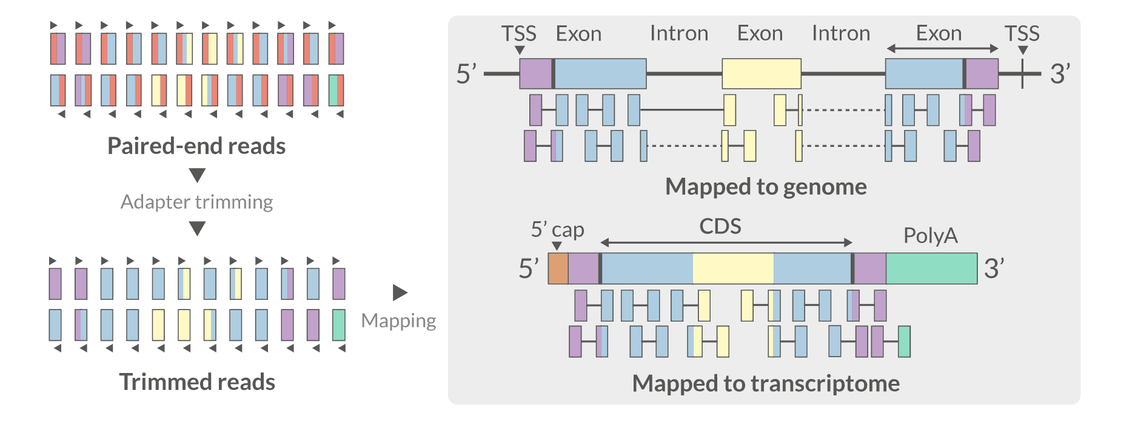
Genome vs Transcriptome?
Red = adapter
Red is gone!

Slide 23
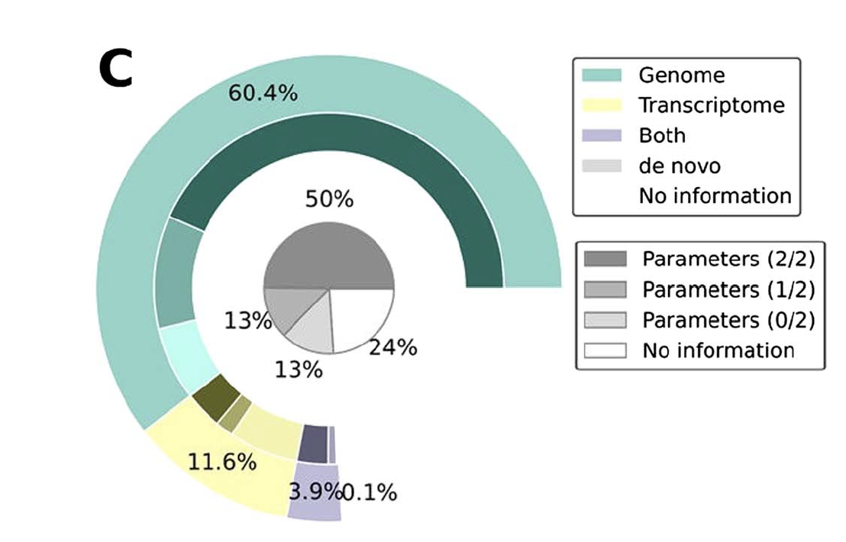
What the scientific community does
Simoneau et al. 2021

Slide 24
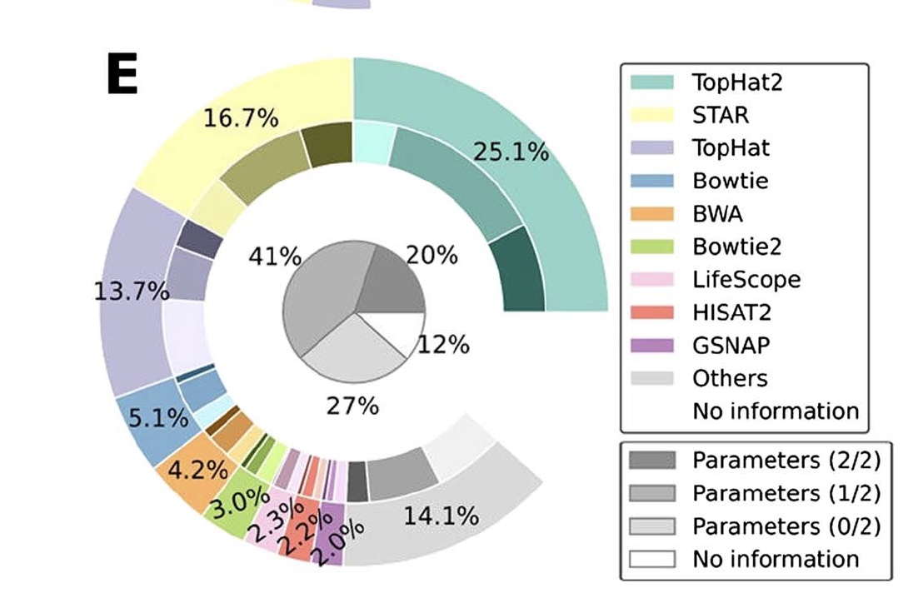
Programs available
Genome
Transcriptome
TopHat2
STAR
Bowtie2
BWA
HiSat2
Salmon
Kallisto
Sailfish

Slide 25
Programs available
Genome
Transcriptome
TopHat2
STAR
Bowtie2
BWA
HiSat2
Salmon
Kallisto
Sailfish

Slide 26
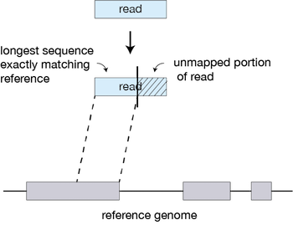
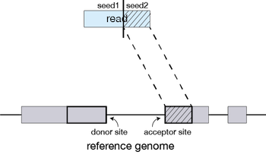
Notes:
STAR will search for the longest sequence that exactly matches one or more locations on the reference genome. STAR will then search again for only the unmapped portion of the read to find the next longest sequence that exactly matches the reference genome, which will be seed2.

Slide 27
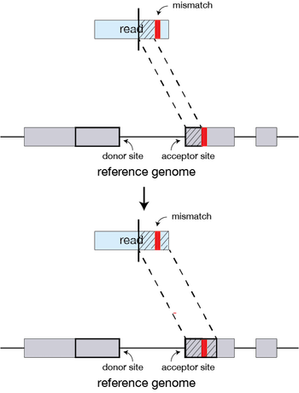
If the program does not find an exact matching sequence for each part of the read due to mismatches or indels, the previous mismatch will be extended.
Notes:
If STAR does not find an exact matching sequence for each part of the read due to mismatches or indels, the previous MMPs will be extended.

Slide 28
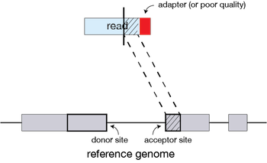
If extension does not give a good alignment, then the poor quality or adapter sequence (or other contaminating sequence) will be soft clipped.
Notes:
If extension does not give a good alignment, then the poor quality or adapter sequence (or other contaminating sequence) will be soft clipped.

Slide 29
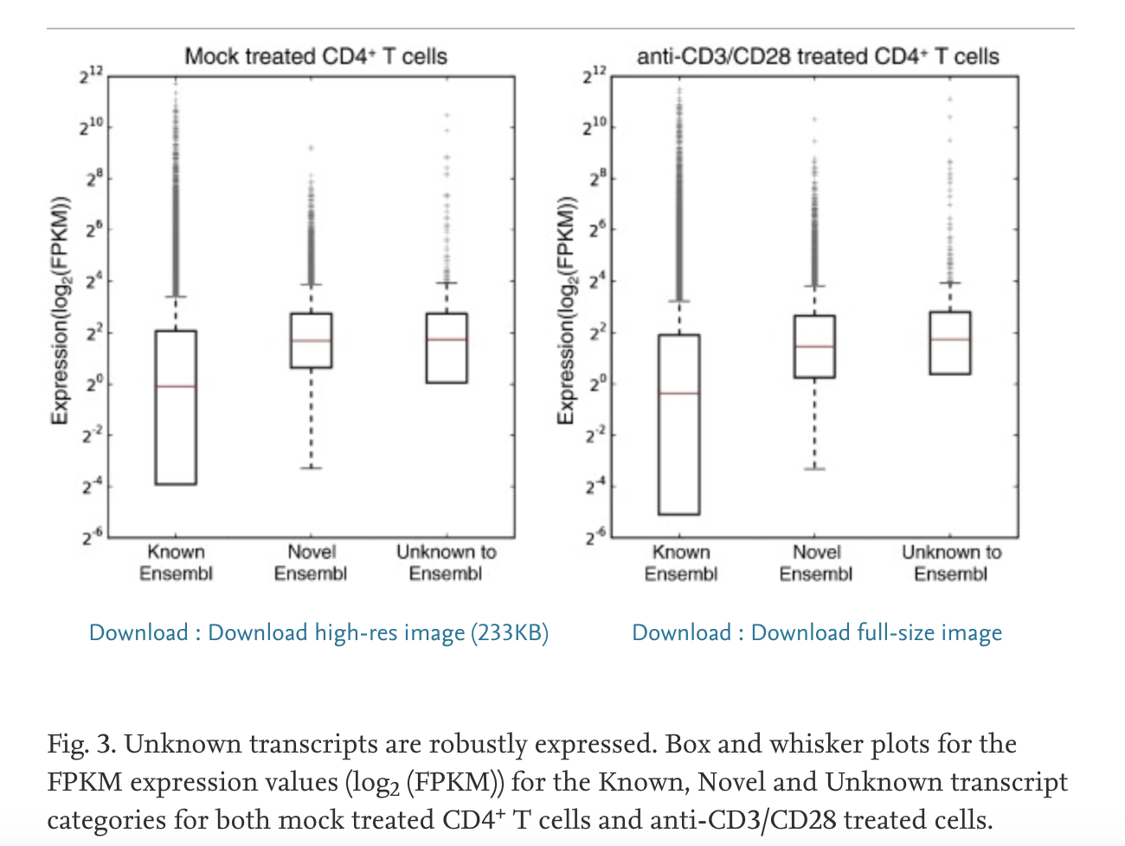
Genome
Transcriptome
Creation of BAM- visualization file
>90% of RNA-seq reads to map to human genome
Transcript discovery & counting
Mice - Transcripts unknown to Ensembl represent as much as 5% of the transcripts that are robustly expressed
BAM not created
Mapping is only as good as the reference – slightly lower reads mapped
Does not allow for transcript discovery
Hutchins et al.
Notes:
Mapping solely to the reference transcriptome of a known species precludes the discovery of new, unannotated transcripts and focuses the analysis on quantification alone. Alignment to the transcriptome is limited to known transcripts, therefore it is highly dependent on the annotation.

Slide 30
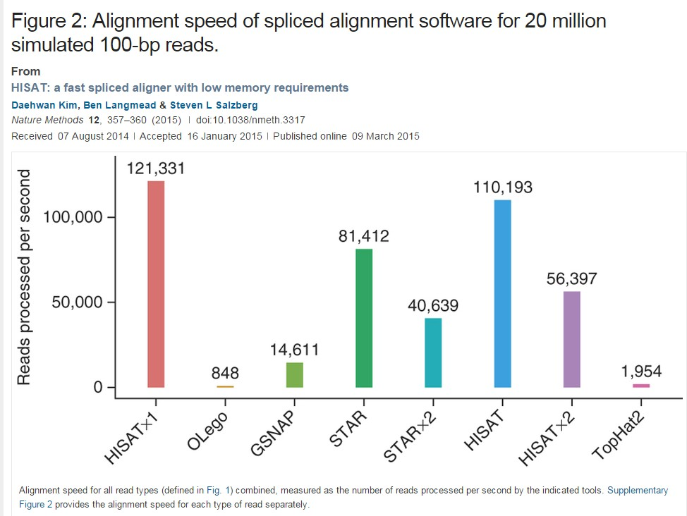
Aligners - Speed and Memory

Slide 31
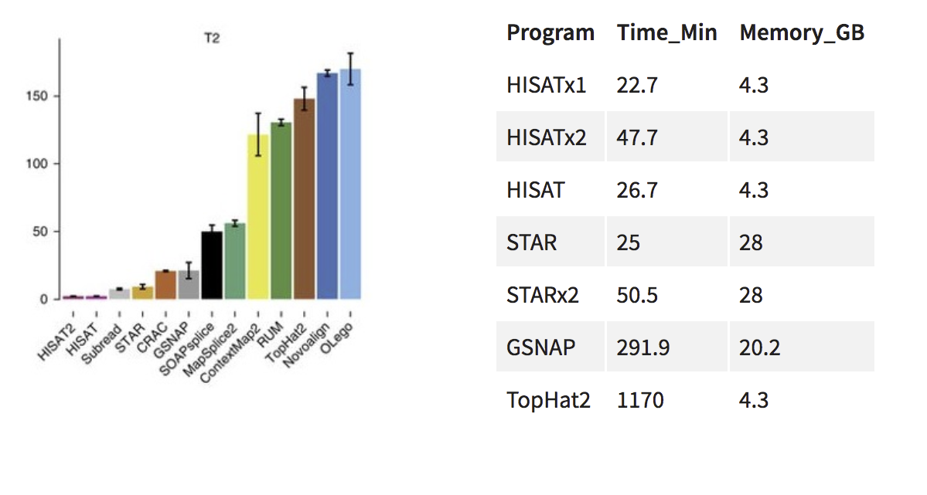
Aligners - Speed and Memory

Slide 32
Reference genomes and annotation
Irrespective of the type of read-mapping, the presence of a reference sequence as well as gene annotation are fundamental
Reference sequence = what are you aligning to?
Gene annotation = which parts of the reference sequence correspond to genes?

Slide 33
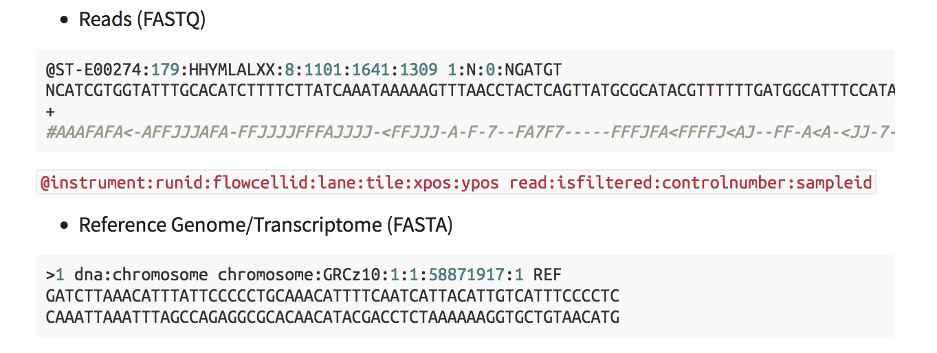
Reference Genome
The reference genome are usually stored in a plain text FASTA file

Slide 34
Annotation
Used to quantify the number of reads which align to different genome features
In the form of a GTF or GFF file

Slide 35
GTF files
Chrom
Feature type
Start
End Strand
Metadata
1 | ensembl | gene | 4430189 | 4450423 . + | . | gene_id | "ENSACAG00000011126"; | gene_name "TMEM1
1 | ensembl | transcript | 4430189 | 4450423 . + | . | gene_id | "ENSACAG00000011126"; | transcript_id
1 | ensembl | exon | 4430189 | 4430804 . + | . | gene_id | "ENSACAG00000011126"; | transcript_id
1 | ensembl | CDS | 4430503 | 4430804 . + | 0 | gene_id | "ENSACAG00000011126"; | transcript_id
1 | ensembl | start_codon | 4430503 | 4430505 . + | 0 | gene_id | "ENSACAG00000011126"; | transcript_id
1 | ensembl | exon | 4439303 | 4439440 . + | . | gene_id | "ENSACAG00000011126"; | transcript_id
1 | ensembl | CDS | 4439303 | 4439440 . + | 1 | gene_id | "ENSACAG00000011126"; | transcript_id
1 | ensembl | exon | 4443852 | 4443930 . + | . | gene_id | "ENSACAG00000011126"; | transcript_id
1 | ensembl | CDS | 4443852 | 4443930 . + | 1 | gene_id | "ENSACAG00000011126"; | transcript_id
1 | ensembl | exon | 4445846 | 4450423 . + | . | gene_id | "ENSACAG00000011126"; | transcript_id
1 | ensembl | CDS | 4445846 | 4446022 . + | 0 | gene_id | "ENSACAG00000011126"; | transcript_id
1 | ensembl | stop_codon | 4446023 | 4446025 . + | 0 | gene_id | "ENSACAG00000011126"; | transcript_id
1 | ensembl | five_prime_utr | 4430189 | 4430502 . + | . | gene_id | "ENSACAG00000011126"; | transcript_id
1 | ensembl | three_prime_utr | 4446026 | 4450423 . + | . | gene_id | "ENSACAG00000011126"; | transcript_id
Tab-delimited text files

Slide 36
Where to find genomic files
General biological databases: Ensembl, GENCODE, and UCSC
Organism-specific biological databases: Wormbase, Flybase, CryptoDB, etc. (often updated more frequently, so may be more comprehensive)

Slide 37
Good practice
Always use the same biological database for all data files (FASTA + GTF)
Always ensure you know exactly which version of a genome and annotation you are working with

Slide 38
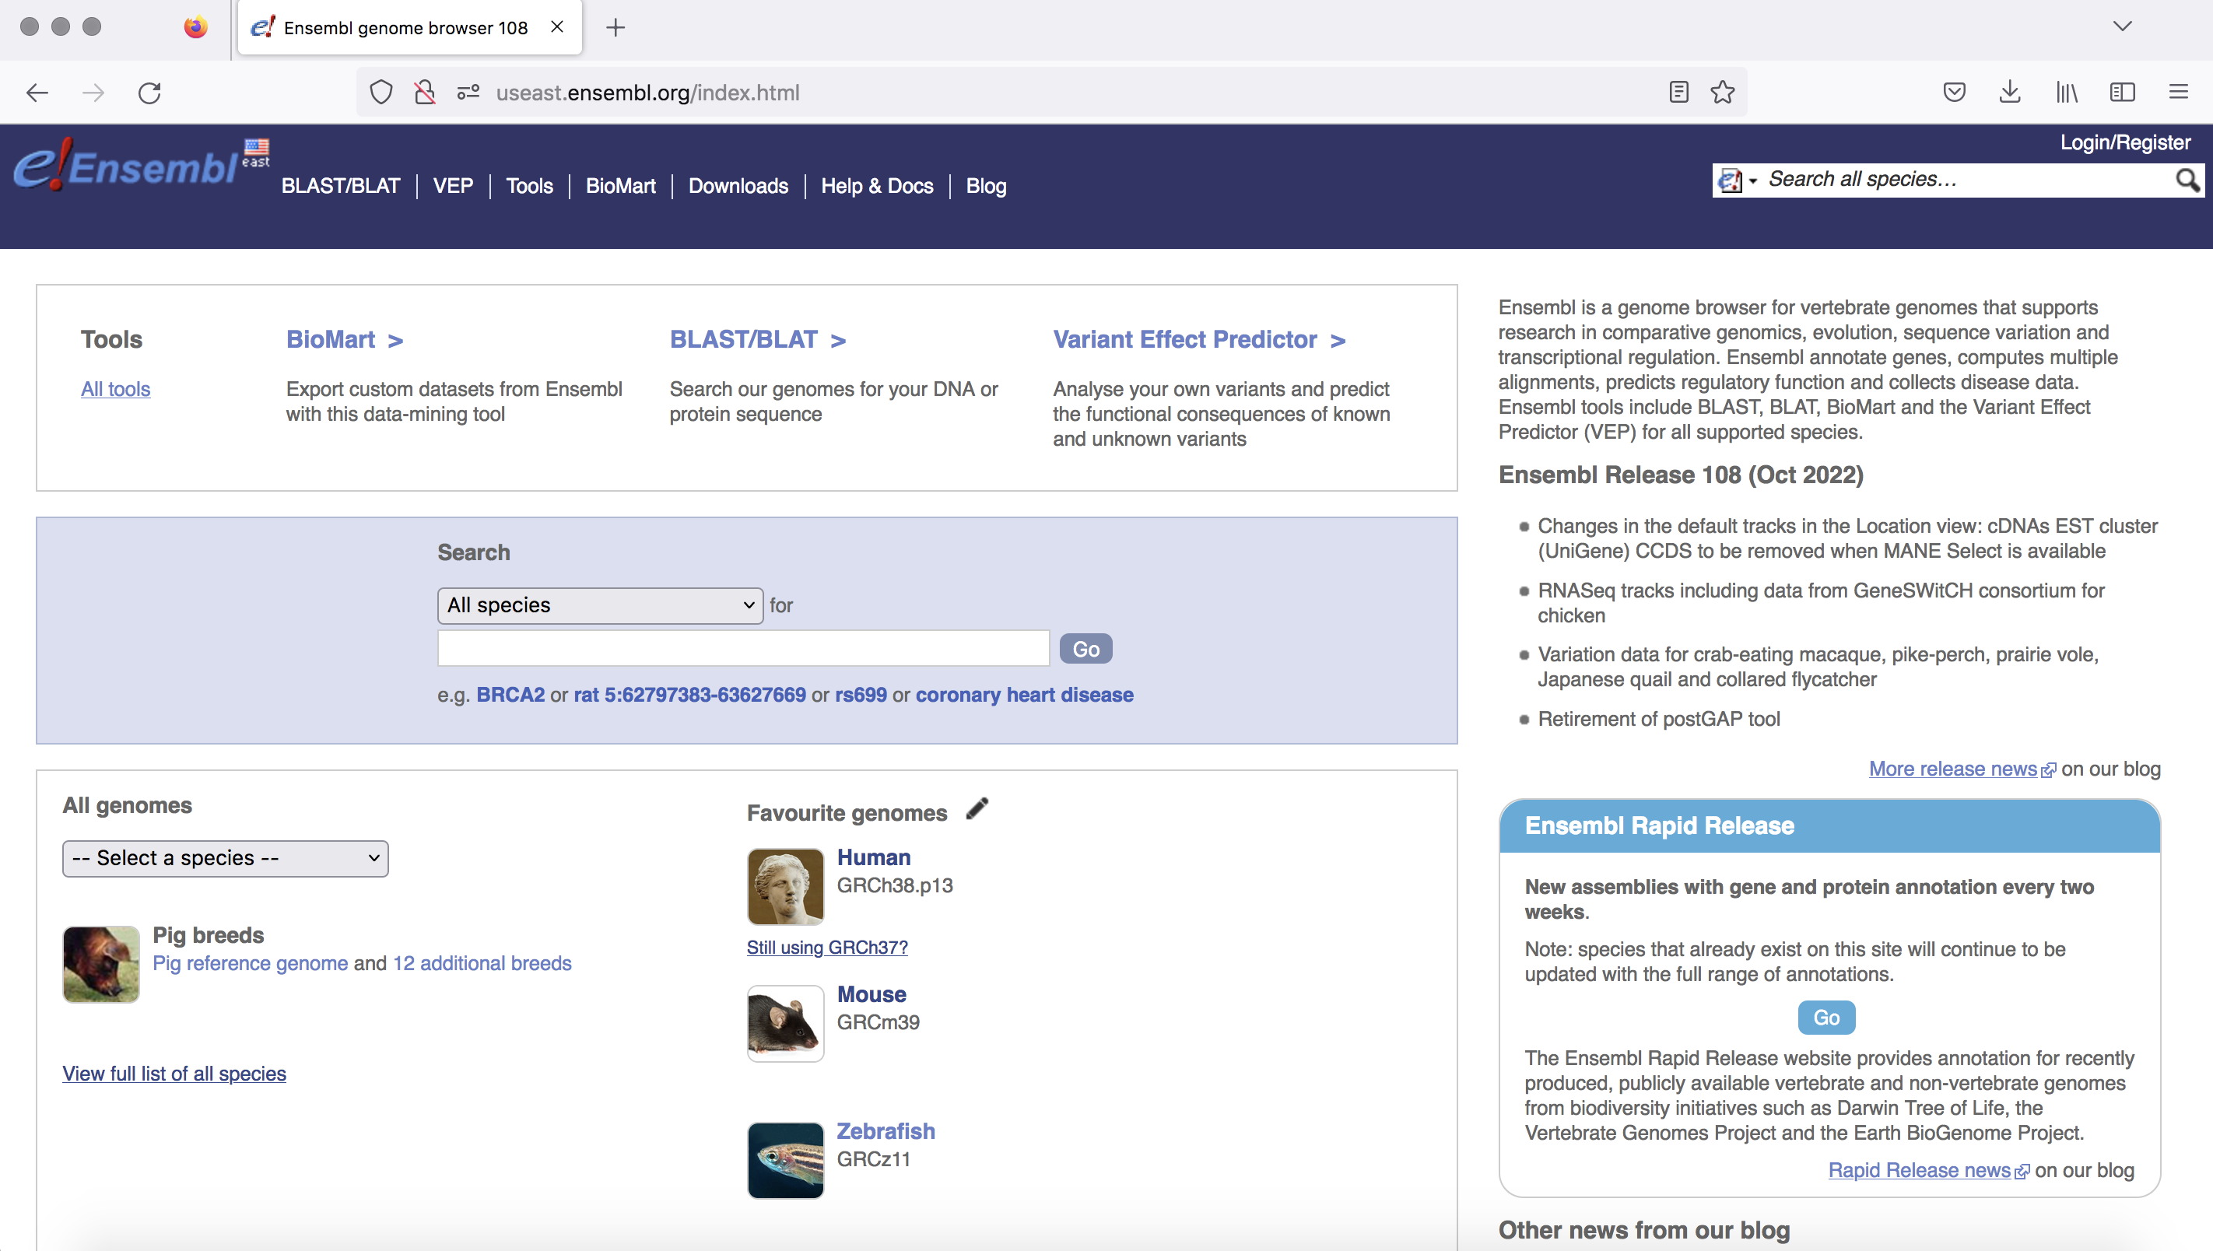
Ensembl

Slide 39
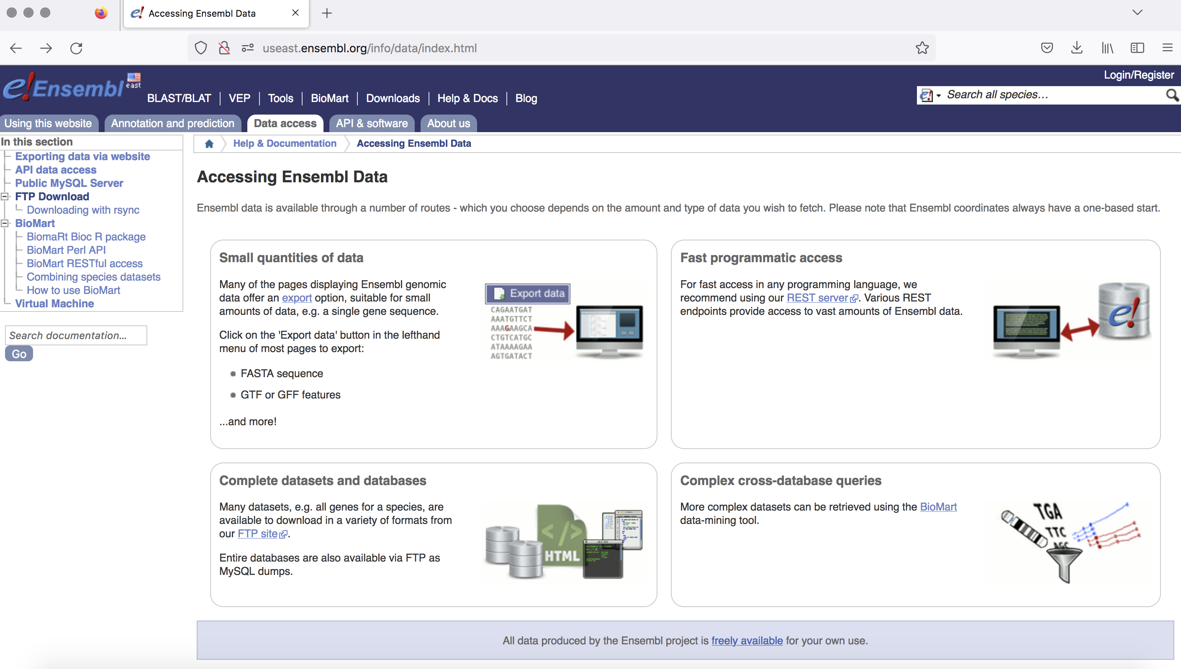

Slide 40
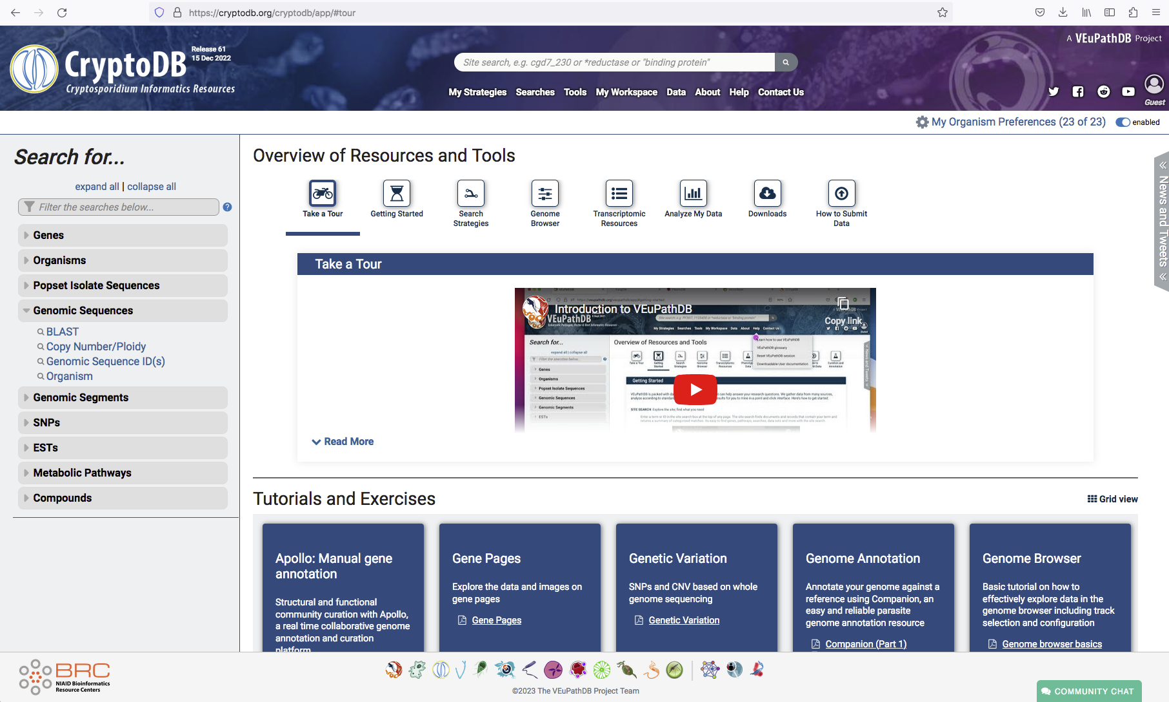
Organism-specific biological databases: CryptoDB

Slide 41
1
2
FASTA
reference
GTF
Indexed Genome*
READY FOR ALIGNMENT

Slide 42
Class activity #2 indexing genomes

Slide 43
1-on-1 Time
Conda installation – I’m going to triage these for another time. Apologies, but I would like to get everyone ready for HW#8.
If you want my advice on a paper/dataset, please email the paper and GEO accession number and I will get back to you Wednesday.
Other questions: HW#8 specific, i.e. How to fill out Metadata? Please stay.
If you have any other questions, not in these categories, please raise your hand now.

